Slide 1
Demystifed
By Kent Peek
Notes:
Why I Created This Talk
Questions:
Whose used Git before?
Whose used other VCS before, like SVN or TFS?
Anybody found themselves copy/pasting commands from StackOverflow without knowing what they do?
How about cringing before merging or getting latest?
That was me! I used Git for years before I finally I understood it.

Slide 2
Why Git Demystified
Git is hard
Notes:
Why Git Was Hard For Me
Git was hard for me for a number of reasons, but I think mostly because of the way I learned it.
I had used TFS and SVN for years. Then a colleague convinced our team to switch to Git.
I figured it can be that different from what I already knew, so I read a couple tutorials on “how to use Git” and I was immediately lost in Git commands that didn’t make sense because I was trying to apply those to what I knew from previous VCS.
So I just decided that Git is hard and complicated and that’s how it stayed for a couple years. Of course I had to continue to use it and it was painful sometimes. Until finally, about a year ago, I finally decided to try to figure this Git stuff out and then I realized….

Slide 3
Why Git Demystified
Git is hard different
Notes:
Git isn’t hard, it’s just different
So since one of my errors was to jump straight into Git commands…
I want to try a different approach wit this talk: first, we cover the core concepts, and then we can dig into some of the practicalities.
In fact, I’m not going to talk about Git commands today. You will see some, but I don’t want you to get hung up on syntax. Just focus on the concept and you’ll be good.
Fundamentally, Git IS a command-line tool. But honestly, 95% of the time I personally use a GUI tool anyway. And when I do need to look up a command…I consult the oracle of StackOverflow.
So with that, let’s talk about how Git is different

Slide 4
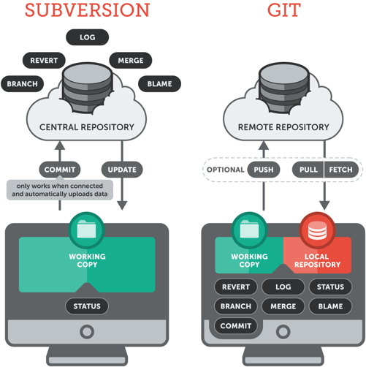
DISTRIBUTED VS CENTRALIZED
Notes:
Distributed
Possibly the most confusing aspect of Git for those who have previously used a centralized VCS, such as TFS, SVN or Perforce, is it's distributed nature.
In a centralized VCS, the repository exists solely on a remote server. And therefore every operation has to be done on the server - For example, to create a new branch you make the request to the server, it does all the work and then hands you the result. Which means that in order to do anything with a centralized VCS you need a connection to the server.
But with Git each user has a complete, local copy of the repository on his/her computer. This local repo contains the full set of files and file history and has the same functionality as the remote repo. All operations in Git, such as committing, creating branches, merging, calculating diffs - all these operations are performed on your local machine against your local repository.
This is one of the main reasons why Git is so fast - every operation is done right there on your local machine. It also means you can continue to work without an internet connection.
So, in this regard, Git can be more complex. With a centralized VCS you simply change some files, check them in and …. Voila! Your changes are immediately sent to the central repository and available to the rest of the team. But with Git, when you “commit” your changes - those changes are only committed to your local repository. And then some time later you might sync those changes with the remote repo.
We'll circle back to syncing with remote repositories later. For now, everything we're going to talk about happens on your local repository.

Slide 5
SNAPSHOTS, NOT DIFFERENCES
Other Version Control Systems
Notes:
Another major difference with Git is the way it thinks about its data.
Conceptually, most other systems store information as a list of changes made to each file over time. In TFS they're literally called "changesets".
Explain graphic
So if you think about that, if you make a request to the server to get version 4, it has to start at version 1 and iterate through each version applying those changes until it’s built up to version 4.

Slide 6
SNAPSHOTS, NOT DIFFERENCES
Git
Notes:
Git doesn’t store its data this way.
Instead, Git thinks of its data more like a set of snapshots of the filesystem at a given point in time.
Every time you commit, it basically takes a picture of what all your files look like at that moment and stores a reference to that snapshot.
So if you want to check out version 4 of this repo, it doesn't have to build up to version 4 – it just grabs A2, B1 and C2 from your local repo and you’re done.
This is another reason why Git is so fast, since a particular version of a file doesn’t have to be “assembled” from its diffs—the complete version of each file is available from Git's local repository.

Slide 7
SHA-1
Everything in Git is check-summed using a SHA-1 hash.
A SHA-1 hash is a 40-character string calculated based on the contents of a file or directory structure.
A SHA-1 hash looks like this:
72fc1bf55b68d649bcd9c53a7d3a857156b24fb5
Often shortened to the first 6-8 characters:
72fc1b
Notes:
Another difference is that …
Everything in Git is check-summed using a SHA-1 hash before it's stored
This is a 40-character string calculated based on the contents of a file or directory structure in Git.

Slide 8
HASHING DEMO
Notes:
http://www.miraclesalad.com/webtools/sha1.php
http://passwordsgenerator.net/sha1-hash-generator/
http://www.sha1-online.com/
public class Person
{
public string FirstName { get; set; }
public string LastName { get; set; }
}
“deterministic”

Slide 9
COMMIT
A commit is a snapshot of your complete project at a certain point in time
Notes:
Git is all about commits. You stage commits, create commits, view old commits, transfer commits between repositories. Most Git commands operate on commits.
But what is a commit exactly? Well, a commit is that snapshot of your project that I referenced earlier.
It marks a specific version of your project. It knows exactly how all of your files looked and can therefore be used to restore them to that state.

Slide 10
WHAT IS A COMMIT ?
Notes:
This is a screenshot I made from an excellent tool called Tower. Most tools will show something similar.
Each commit contains
The author’s name and email
the date of the commit
The commit message entered by the author to describe the changes
Hopefully, you create better commit messages than me
A reference to the snapshot of the files you staged.
The SHA-1 hash of the commit’s contents - commit’s unique id
calculated based on the content of the files, the directories, the committer, the commit message, and several other factors.
a pointer to the commit that came before it

Slide 11
COMMITS FORM A CHAIN
Notes:
Since every commit references the commit that came before it, you end up with a chain of commits that build on each other

Slide 12
COMMIT DEMO
Notes:
Introduce https://learngitbranching.js.org/?NODEMO
<ADD A FEW COMMITS>
Now, you probably noticed this label that says “master”. “master” is the name of the current branch.
So what the heck is a branch, Kent? I’m glad you asked…

Slide 13
BRANCHING
Notes:
Branching.
First, let’s talk about what branches are and why you’d want to use them.
As software developers, we often work on different contexts in parallel. For example, let’s say while in the middle of developing a new feature, you're told you need to drop everything and work on an emergency bug fix. What do you do with the changes you already have for the feature? You don't want to throw them away, but you don't want to check your incomplete code in yet either.
The solution is to have separate "branches" of development. So when you want to add a new feature or bug fix you spawn a new branch to encapsulate those changes. Then when your changes are complete, you merge them into the main code base.
This allows you to work on different sets of changes, or contexts, independently, and it also keeps the main code base clean from unfinished changes.
Now, branching is not unique to Git – most other VCS have it. Git just does it better. In fact, Git is almost synonymous with branches. But…
<TRANSITION>
…what if I told you….that there are no branches in Git. Well, at least not in the way you might think.

Slide 14
BRANCHING
Notes:
In other VCS, and this is how you might imagine a branch works in Git too, a branch is just a copy of the repository. Has anybody here created a branch in a TFS repository with 1000’s of files? It's gnarly.
Git branches are much more lightweight than that.
Instead of copying all files in the repository to a new folder, Git stores a branch as a reference to a particular commit.
And since each commit, in turn, references a parent commit, a branch represents a series of connected commits.

Slide 15
BRANCH
A branch is simply a named pointer to a commit
Notes:
It's important to understand that branches are just pointers to commits.
Branches are not containers…they’re simply named pointers to particular commits.
It’s just a human-friendly alias – because we humans tend not to like to name things as 40 character hashes. We just want to call it ‘master’ – or ‘NewLoginFeature’

Slide 16
BRANCHING DEMO
Notes:
So if we go back to our demo we can see what that looks like.
First, point out that master is the default branch
<Create new commit> branch alias is a moveable pointer
When you create a new branch, all you’re doing is creating another alias to the current commit
Notice the asterisk – this indicates which branch is currently checked out. This tool uses an asterisk, but usually that’s denoted by the word HEAD
If we create a new commit, the ’master’ pointer is advanced, but the ‘feature’ pointer remains pointed at C3.
Checkout feature. Create new commit. Show that branches have diverged.
You can delete a branch, but all you’re actually doing is deleting the named pointer – the commits are still there in the repository.
This raises an interesting scenario. The reason these commits are grayed out is because there are currently no references to them. They are, for all intents and purposes, orphaned. Git will keep these commits in the repository for at least 30 days, after which it may delete them as part of it’s “garbage collection”.
So this is good news because it means that even if you end up “deleting” or “orphaning” some commits, they are still there for at least a month. You can get them back. In general, it’s very hard to lose information in Git.

Slide 17
BRANCHING STRATEGIES
Notes:
Now, there are LOTS of ways to use branches and some teams have very sophisticated branching strategies – that is: rules and guidelines on when and how to branch.
This is a popular (albeit very complex) one called GitFlow.
I’m not going to get into the different branching strategies, but just know that there’s a ton of guidance out there on how and when to branch. But be forewarned: It’s a very opinionated subject!

Slide 18
MERGING
1
Two Types of Merge:
Fast-Forward Merge
3-Way Merge
Notes:
Separating your work into branches is good practice, but at some point your changes will need to be integrated with the rest of the project
This is where the "git merge" command comes in.
<NEXT SLIDE>
In Git, there are two types of merges: fast-forward and 3-way
It’s really simpler than it sounds – the difference is just whether or not the branches have diverged.
Let’s take a look

Slide 19
MERGING DEMO
Notes:
First, fast-forward - just move the branch pointer forward
Then, 3-way merge
Create a new ’feature’ branch, check it out and add a few commits
“Meanwhile”, either you or another person on your team has added a couple commits to the master branch. So now our branches have diverged. Master has commits that feature does not, and vice versa.
So when we go to merge the feature branch into master --- it will create a new commit that has two parents: one to the tip of the master branch and one to the tip of the feature branch
This is called a “merge commit”

Slide 20
MERGE COMMITS
Notes:
Merge commits are very common. Most tools will create them for you automatically.
Which can be very confusing because when you look at the history, you see these mysterious commits that you didn’t create.
So now you know what they are. it's just a commit that binds two branches together.

Slide 21
MERGE CONFLICTS
Notes:
Which brings us to….“Merge conflicts” – that phrase alone is enough to make many developers cringe.
Now, in the examples I’ve given there were no merge conflicts. In other words, the assumption was that the same files weren’t changed in the branches that were being merged.
But what happens when you’ve changed the same file in both branches? Then you get the dreaded merge conflict.
Now, sometimes the tool you’re using can resolve these conflicts for you automatically. For example, if in one branch you changed the top line of the file and in the other branch you only changed the bottom line of the file, then Git can figure out that it should create a new version of the file with both changes.
That’s an important point: the merge commit that gets created will have a new version of the files that were conflicted!
But what if you changed the same line of the file in both branches? That’s where you have to get involved and tell Git which version of the changes you want.

Slide 22
MERGE CONFLICTS
Notes:
Typically, you’ll use a diff tool like this, that shows the changes from each branch and allows you to select which changes to keep.
Now, I’m not going to get into how to resolve merge conflicts. Each tool has a slightly different workflow and you’ll just need to read the documentation.
What I will say is this: ….

Slide 23
MERGE CONFLICTS
Don’t panic
You cannot break things (irrevocably)
Take Your Time
Notes:
Don’t Panic!
Nobody likes resolving merge conflicts. They’re tedious and frustrating and can be nerve wracking – believe me, I suffered my share of nasty merge conflicts!
If merge conflicts scare you because you’re worried about messing things up, just know that Git makes it really hard to break things without a way to undo it.
Merging is done on your local – you can reset.
if you do accidentally push a bad merge - you can revert entire commits and start over.
So my advice is to just slow down. Take your time. And remember: StackOverflow has the answer!

Slide 24
MERGE VS REBASE
Notes:
Speaking of StackOverflow...
You’ll see a lot of talk on the internet about merging vs rebasing.
Both are ways to integrate changes from one branch to another. They just differ in how they accomplish that.
Merge keeps the commits from both branches and creates a new commit that merges them together.
Rebase, on the other hand, creates new copies of the commits from the branch you’re merging.
The way to think of rebasing is it’s recreating the work of one branch onto another.
Why would you want to do that? In short – it can keep your history neater. When you have lots of developers working on lots of different branches in the same repository, you can get some gnarly, mangled history.
Rebase allows you to make it look like all the commits were created on the same branch.
Sounds great! Why wouldn't you want to do that. Well, pros and cons…With rebase you get a clean history, but you lose a record of what actually happened. Also, rebase, if used incorrectly can break things.
This is another one of those topics that can be pretty opinionated. I’m not gonna tell you which one to use, but I would urge you to master merging before delving into rebasing.

Slide 25
THE THREE AREAS
Working Copy
The directory on your computer that contains the project’s files.
Also called “working directory” or “working tree”.
Step 1: Change some files in your working copy
Staging Area
Changes added to the staging area will be included in the next commit
Step 2: Add changes selectively to the staging area
Repository
Data store for commits (snapshots).
The ”.git” folder.
Step 3: Commit staged changes to the repository
Notes:
There are three areas in Git where files are stored.
The working copy is the directory on your computer that contains the project’s files. This is also called the “working tree” or “working directory”. A better name is probably just “the file system”.
<TRANSITION>
The repository is the data store for your commits. In Git, this is just a hidden folder in your project’s root directory named ”.git”. You don't have to (and, moreover, should not) touch anything inside this magical folder.
Now, with most other version control systems, these are the only two places to store data … but there’s a third area in Git <TRANSITION> called the “staging area” (also sometimes called the “index”).
Instead of committing all of the changes you've made since the last commit, the stage lets you group related changes into highly focused snapshots before actually committing it to the project history.
This means you can make all sorts of edits to unrelated files, then go back and split them up into logical commits by adding related changes to the stage and commit them piece-by-piece.
This makes it easier for other members of your team to understand the changes.
So the flow goes like this:
Step 1: change some files in your working copy. Then, add changes selectively to the staging area. Finally, commit those staged changes to the repository.

Slide 26
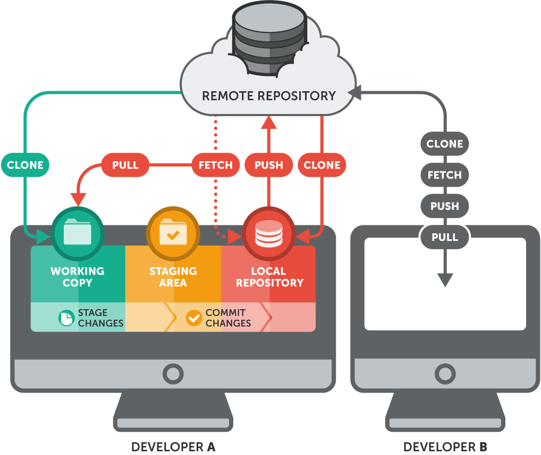
SYNCING WITH REMOTE REPOSITORIES
Notes:
OK, so everything we’ve talked about so far happens on your local machine in your local repository. But at some point you need to share your changes with others.
The way we do that is we upload our commits to the shared repository and download any new commits that have been added by others.
4 commands:
git clone
git push
git fetch / pull
sync

Slide 27
GitHub

Slide 28
PULL REQUESTS
Notes:
Pull requests are a way to request that a repository admin pull in your changes.
They’re very popular with open source projects, like on GitHub.
With open projects, you can’t just let anybody commit their own changes to your repo – you need some way to filter out good / bad changes. This is what pull requests do.
So the way a pull request works is a developer clones your repo, creates a branch, commits some changes, and then, instead of pushing those changes directly into your repo, he/she submits a request for somebody with authority to approve changes to pull those changes in.
This gives the approver a chance to do a code review, add comments, etc.
Pull requests are not just for GitHub, though. Many teams use them as part of their own internal process.

Slide 29
REVIEW
Commit
is a snapshot of your complete project at a certain point in time.
Branch
is simply a named, moveable pointer to a commit.
Merging
is the act of integrating multiple branches together.
Notes:
So to this point we’ve learned that:
A commit is a snapshot of your project at a certain point in time, and that these commits link together to form a history.
A branch is simply a named pointer to a particular commit, and therefore it’s chain of ancestors
We’ve learned how to merge changes from one branch into another, the different types of merging and even a little about rebasing.

Slide 30
REPOSITORY
A Git repository is a collection of commits, each with their own unique hash, that reference other commits.
Notes:
The “repository” is just a collection of commits.

Slide 31
REVIEW
Fetch
retrieves commits from the remote repository to your local repository only.
Pull
applies the latest commits from the remote repository to your working copy
Push
uploads commits from your local repository to the remote repository

Slide 32
THANKS (and visit our sponsors!)
Notes:
Git foo

